Slide 1



Introduction to System Architecture and Safety Measures

Slide 2
Overview
Software Architecture
Safety Measures

Slide 3
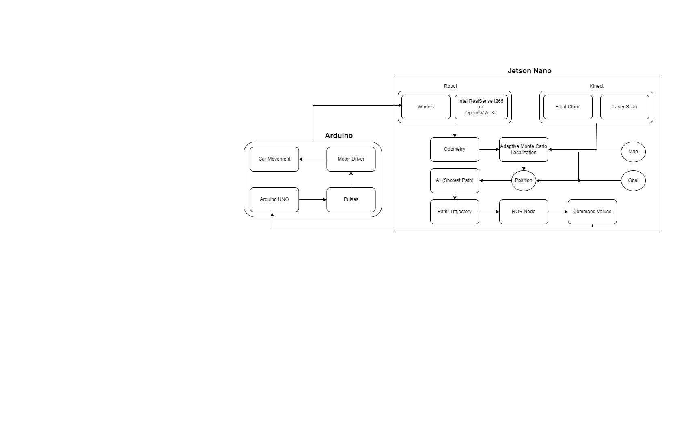
Overview
System Architecture

Slide 4
Overview
Robot will define odometry
Environment will be defined by Kinect
Command Values are transferred to Arduino by Jetson Nano
System Architecture (Jetson Nano)

Slide 5
Overview
Command values will tell the Arduino to move in a certain direction.
Movement is done by powering the gear motors using motor driver.
New location will give the new odometry of the robot.
System Architecture (Arduino)

Slide 6
Overview
Software Architecture
Safety Measures
Case Studies
Actual SDC Safety Measure
Adaptive Cruise Control
Lane Keep Assist
Vehicle-to-Vehicle(V2V) Communication
Our SDC Safety Measure
Destination Guidance
Object Collision Avoidance
What are safety measures in SDC?
Why these safety measures?

Slide 7
Overview
Case 1: March 2018 – Uber
Case 2: December 2018 – Tesla Model X
Case 3: March 2019 – Tesla Model 3
Software Architecture
Safety Measures
Case Studies
Actual SDC Safety Measure
Adaptive Cruise Control
Lane Keep Assist
Vehicle-to-Vehicle(V2V) Communication
Our SDC Safety Measure
Destination Guidance
Object Collision Avoidance

Slide 8
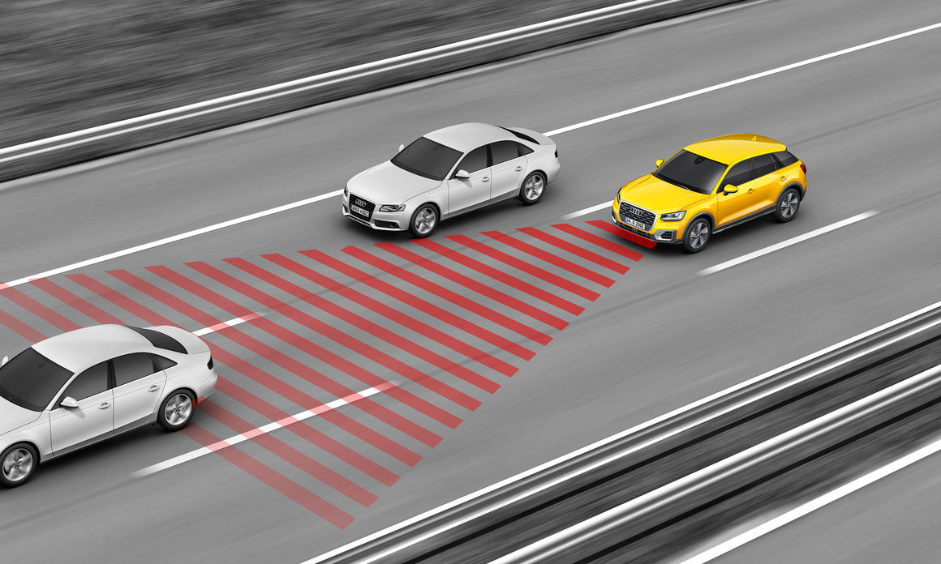
Overview
Software Architecture
Safety Measures
Case Studies
Actual SDC Safety Measure
Adaptive Cruise Control
Lane Keep Assist
Vehicle-to-Vehicle(V2V) Communication
Our SDC Safety Measure
Destination Guidance
Object Collision Avoidance
Source: https://www.audi-mediacenter.com/en/photos/detail/adaptive-cruise-control-42099

Slide 9
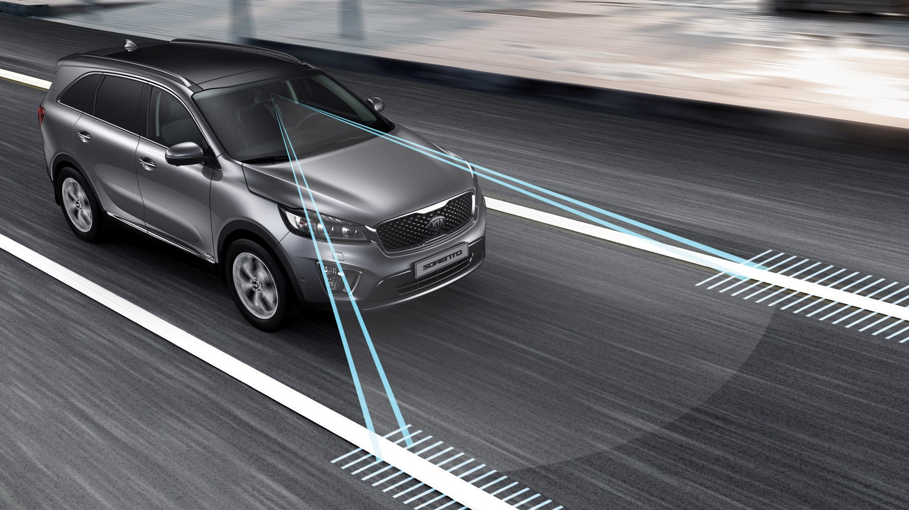
Overview
Software Architecture
Safety Measures
Case Studies
Actual SDC Safety Measure
Adaptive Cruise Control
Lane Keep Assist
Vehicle-to-Vehicle(V2V) Communication
Our SDC Safety Measure
Destination Guidance
Object Collision Avoidance
Source: https://www.pakwheels.com/blog/new-10th-gen-honda-accord-comes-bims-2019/lane-keeping-assist-systems-explained_1/

Slide 10
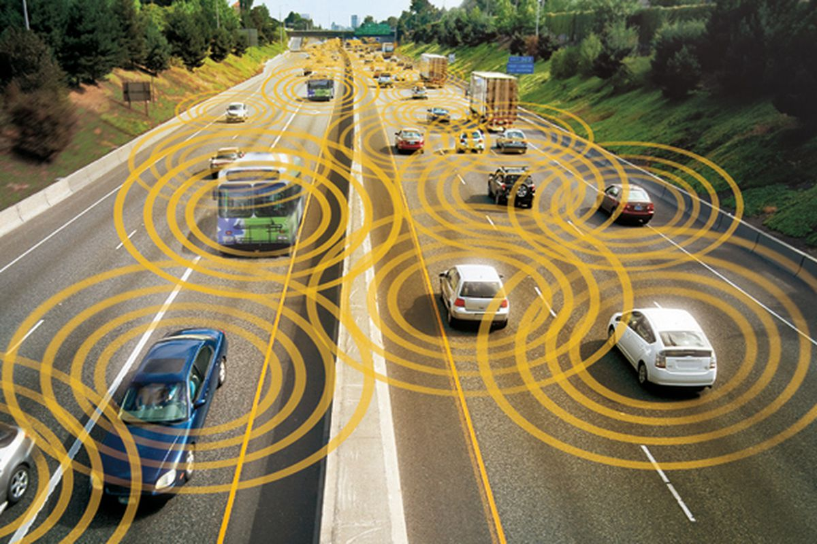
Overview
Software Architecture
Safety Measures
Case Studies
Actual SDC Safety Measure
Adaptive Cruise Control
Lane Keep Assist
Vehicle-to-Vehicle(V2V) Communication
Our SDC Safety Measure
Destination Guidance
Object Collision Avoidance
Source: https://www.theverge.com/2020/4/23/21233085/v2x-vehicle-to-everything-fcc-safety-spectrum-airwaves-wifi

Slide 11
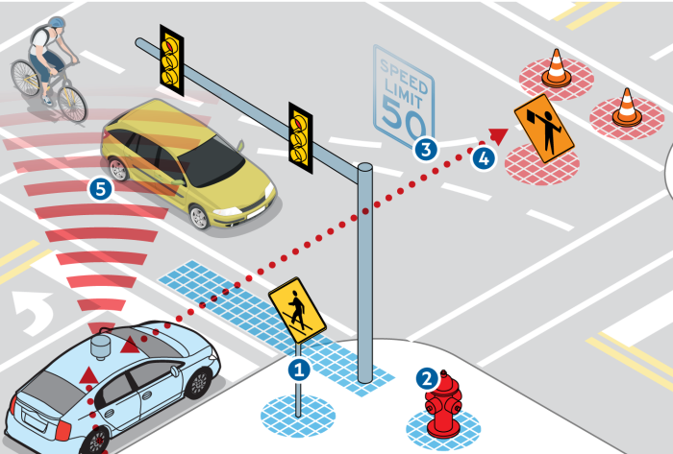
Overview
Software Architecture
Safety Measures
Case Studies
Actual SDC Safety Measure
Adaptive Cruise Control
Lane Keep Assist
Vehicle-to-Vehicle(V2V) Communication
Our SDC Safety Measure
Destination Guidance
Object Collision Avoidance
Source: https://towardsdatascience.com/how-to-make-a-vehicle-autonomous-16edf164c30f

Slide 12
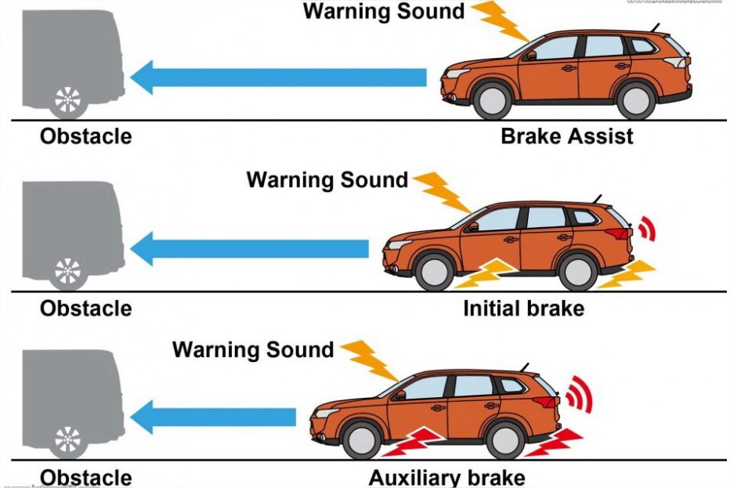
Overview
Software Architecture
Safety Measures
Case Studies
Actual SDC Safety Measure
Adaptive Cruise Control
Lane Keep Assist
Vehicle-to-Vehicle(V2V) Communication
Our SDC Safety Measure
Destination Guidance
Object Collision Avoidance
Source: https://blog.roboauto.cz/how-it-works-collision-avoidance-system-d05bd9807f1a?gi=1ddc2822005b

Slide 13
Thank You

